Slide 1
Semiconductors
A semiconductor is a material with conducting properties between those of a good insulator (e.g. glass) and a good conductor (e.g. copper).
The most commonly used semiconductor is silicon.

Slide 2
Semiconductor Elements in the Periodic Table
Group III
Group IV
Group V
+3
+4
+5
Boron (B)
Carbon (C)
Nitrogen (N)
Aluminium (Al)
Silicon (Si)
Phosphorus (P)
Germanium
Gallium (Ga)
Arsenic (As)
(Ge)
Indium (In)
Tin (Sn)
Antimony (Sb)

Slide 3
Semiconductors
Each silicon atom has an outer shell with four valence electrons and four vacancies (It is a tetravalent element).
In intrinsic (pure) silicon, atoms join together by forming covalent bonds. Each atom shares its valence electrons with each of four adjacent neighbours effectively filling its outer shell.

Slide 4
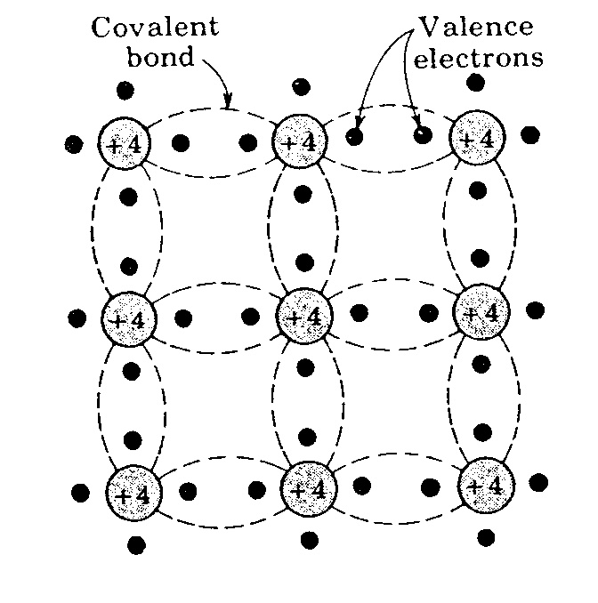
Intrinsic Semiconductors

Slide 5
Intrinsic Semiconductors
The structure has zero overall charge
The complete nature of the structure means that at absolute zero temperature (0 K) none of the electrons is available for conduction…thus far the material is an insulator.

Slide 6
Intrinsic Semiconductors
At room temperature some of the electrons are able to acquire sufficient thermal energy to break free from their bond.
Whenever an electron leaves its position in the lattice it leaves a vacancy known as a hole.
The process is known as electron-hole pair generation

Slide 7
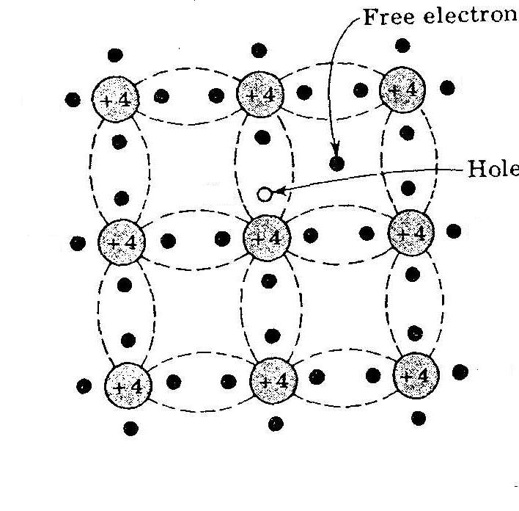
Intrinsic Semiconductors

Slide 8
Intrinsic Semiconductors
A freed electron can move through the body of the material until it encounters another broken bond where it is drawn in to complete the bond or recombines.

Slide 9
Intrinsic Semiconductors
At a given temperature there is a dynamic equilibrium between thermal electron-hole generation and the recombination of electrons and holes
As a result the concentration of electrons and holes in an intrinsic semiconductor is constant at any given temperature.
The higher the temperature the more electron-hole pairs that are present.

Slide 10
Intrinsic Semiconductors
Two mechanisms for conduction become possible when a bond breaks:
1. Due to the movement of the freed electron.
2. Due to neighbouring electrons moving into the hole leaving a space behind it. (This can be most simply thought of as movement of the hole, a single moving positive charge carrier even though it is actually a series of electrons that move.

Slide 11
Intrinsic Semiconductors
When an electric field (voltage) is applied, the holes move in one direction and the electrons in the other.
However both current components are in the direction of the field.
The conduction is ohmic, i.e. current is proportional to the applied voltage (field)

Slide 12
Intrinsic Semiconductors
For an intrinsic semiconductor, the number of electron and hole carriers and thus the conductivity, increases rapidly with temperature.
This is not very useful.
Hence we dope the material to produce an extrinsic semiconductor.

Slide 13
Extrinsic Semiconductors
Intrinsic conduction is very small (see example).
Conductivity levels can be raised and controlled by doping with minute levels of impurity atoms to give extrinsic or doped semiconductors.
Extrinsic semiconductors may be further divided into either n-type or p-type

Slide 14
N-type Semiconductors
An n-type impurity atom has five outer (valence) electrons, rather than the four of silicon.
Only four of the outer electrons are required for covalent bonding. The fifth is much more easily detached from the parent atom.
As the energy needed to free the fifth electron is smaller than the thermal energy at room temperature virtually all are freed.

Slide 15
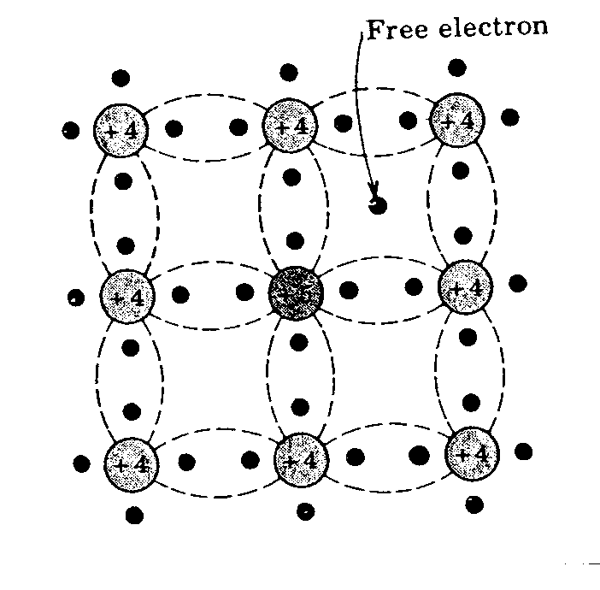
N-type Semiconductors
EXTRA ELECTRON FREE AT ROOM TEMP.
+4
+4
+4
+4
+5
+4
+4
+4
+4

Slide 16
P-type Semiconductors
Here the doping atom has only three electrons in its outer shell.
It is relatively easy for an electron from a neighbouring atom to move in, so releasing a hole at its parent atom. The freed hole is available for conduction.
The energy needed to free the electron from its parent is usually small compared to the thermal energy so each impurity atom contributes one hole for conduction (fully ionised).

Slide 17
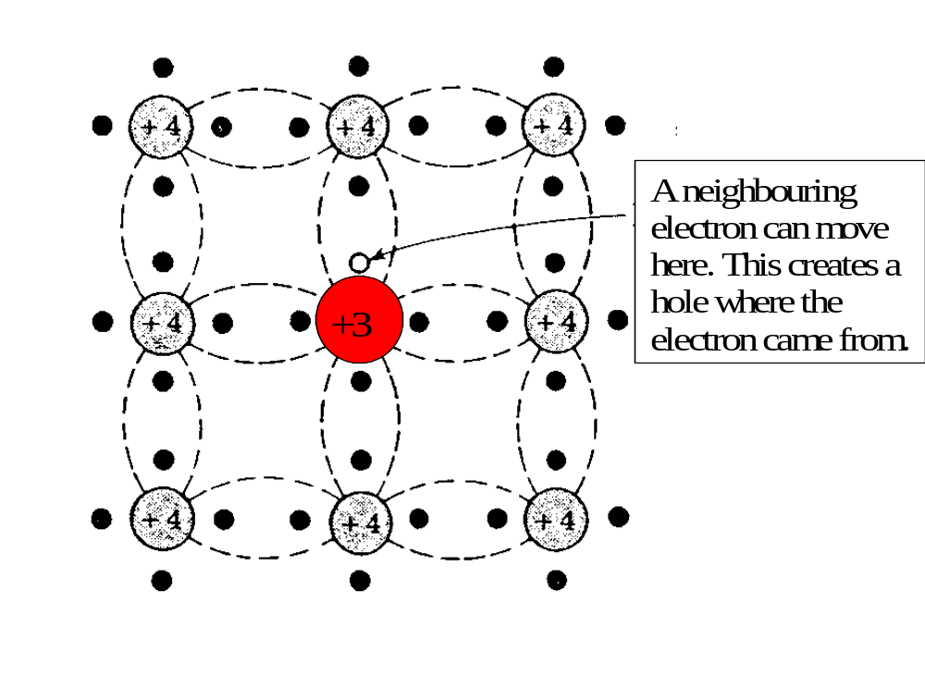
P-type Semiconductors

Slide 18
Temperature sensitivity
In both types of extrinsic semiconductor virtually all available charge carries are freed from their parent atoms at room temperature. Temperature variations thus make little difference to the conductivity σ.
For intrinsic conductivity the number of carriers, and thus σ, increases rapidly with temperature.
For both extrinsic and intrinsic mechanisms the conductivity is zero at T=0 K

Slide 19
Summary
In an N-type semiconductor, conduction is mainly due to electrons (negative charges)
Positive charges (holes) are the minority carriers.

Slide 20
Summary
In a P-type semiconductor, conduction is mainly due to holes (positive charges)
Negative charges (electrons) are the minority carriers.

